Slide 1
SOCIAL ENGINEERING ATTACKS USING BeEF
Bootcon Presentation by Reddy, Munvwa, Sheng, Modesta and Chuk

Slide 2
Introduction into social engineering Attacks?
What is social engineering?
Social engineering is the term used for a broad range of malicious activities accomplished through human interactions. It uses psychological manipulations to trick users into making security mistakes or giving away sensitive information about their user credentials and or login details to a website. When hackers gain access to these vital information they can use them to carry out a cyberattack on the user or hack an organization.

Slide 3
Types of social engineering techniques
In the world of cyber security, various techniques can be used to carry out social engineering. These techniques include;
Phishing
Spear Phishing
Vishing
Mining social media
Pretexting
Smishing
Whaling

Slide 4
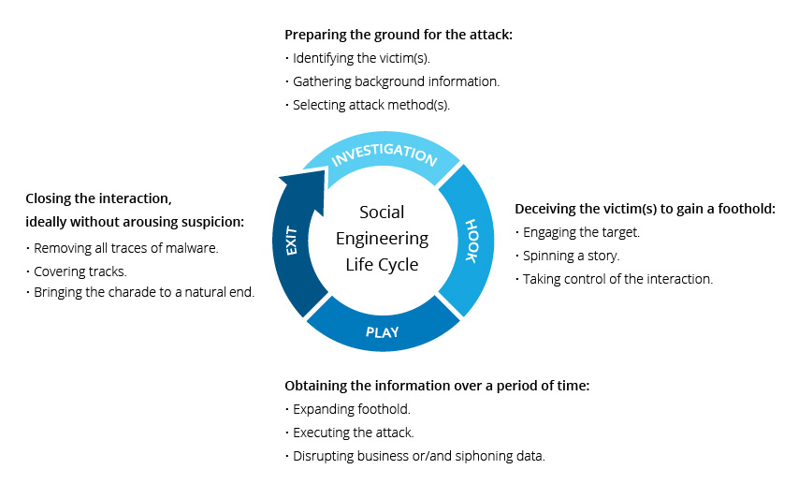
Life cycle of social engineering attack

Slide 5
Some tools for social Engineering
Many open sourced and paid tools can be used to conduct social engineering attack. For the purpose of this presentation, we will be listing some of them with special emphasis on BeEF which we will be using to conduct our research in linux. Other tools are;
Maltego
Social engineering Toolkit SET
Wifiphisher
Metasploit MSF
MSFvenom Payload Creator
BeEF

Slide 6
Using BeEF as a tool for social engineering Attack
What is BeEF?
The Browser Exploitation Framework is an open source tool which hackers or cybercriminals can use to target a victim’s browser as an attack point or beachhead.
It is install by default in Kali distribution. It is located in the /usr/share/beEf-xss/ directory. By default, it is not integrated with the Metasploit framework.

Slide 7
How it works
BeEF is a framework similar to metasploit. It uses javascript hook.js which when executed by a browser, the browser becomes hooked to BeEF. With an infected browser known as zombie, attackers can view and exploit victim’s browser cookies, browser history and many more. Using social engineering skills such as phishing emails victims are tricked into visiting hooked websites.

Slide 8
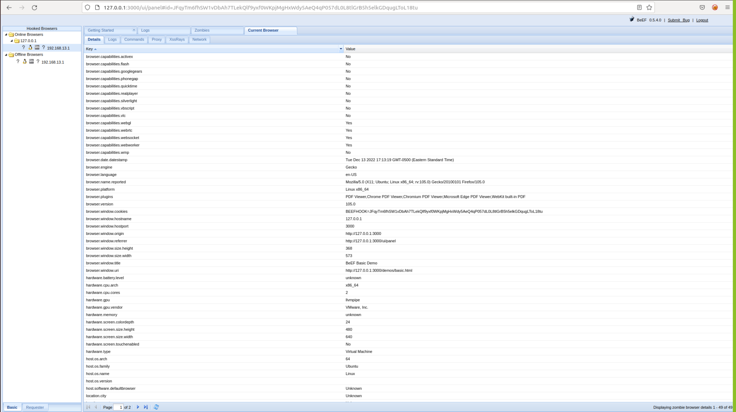
BeEF control panel showing hooked browsers

Slide 9
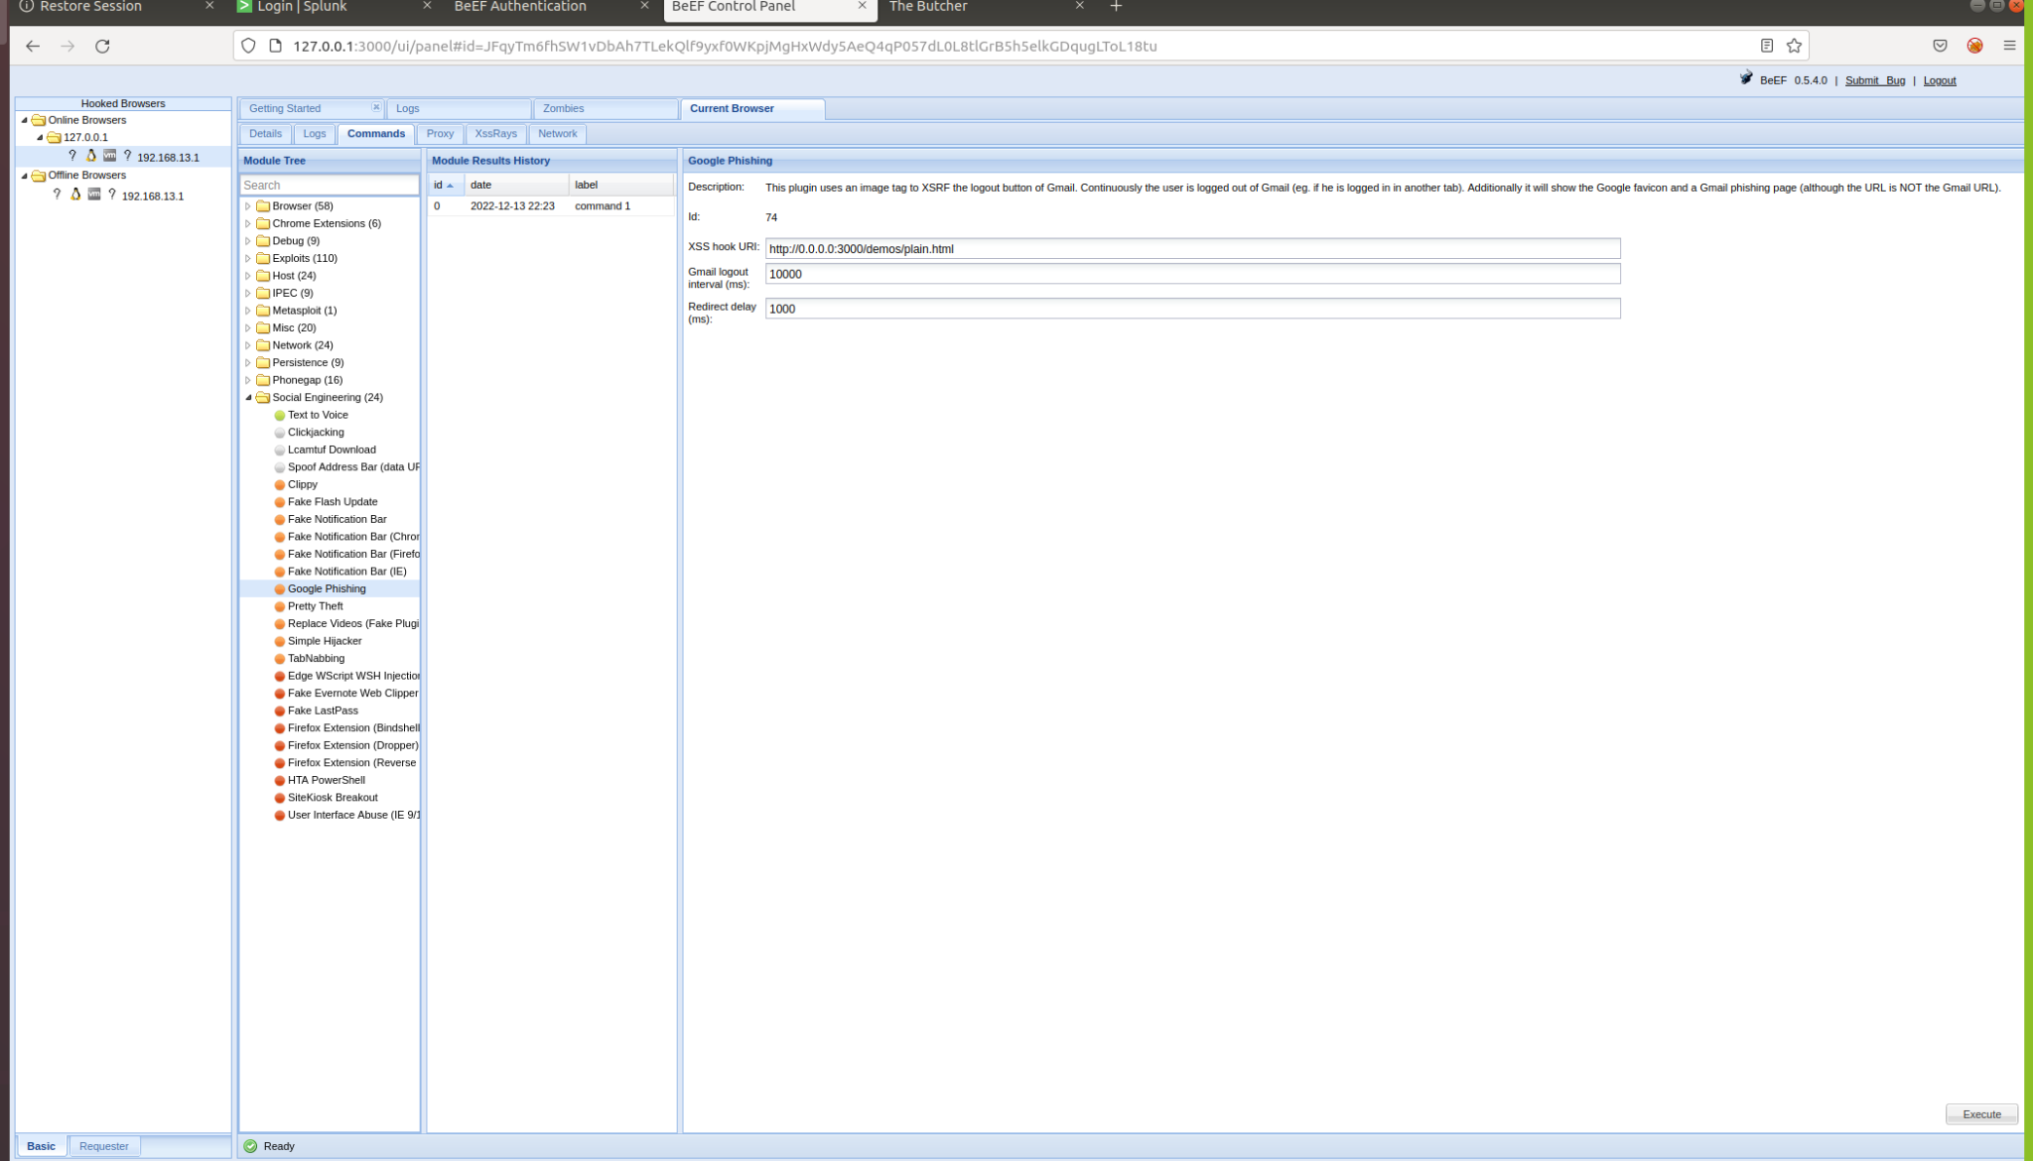
Executing a google phishing exploit inside BeEF contol panel

Slide 10
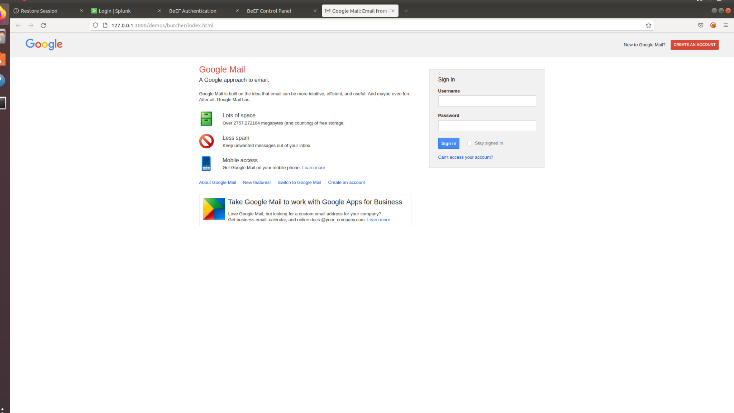
Creating a fake google email login page to capture credentials

Slide 11
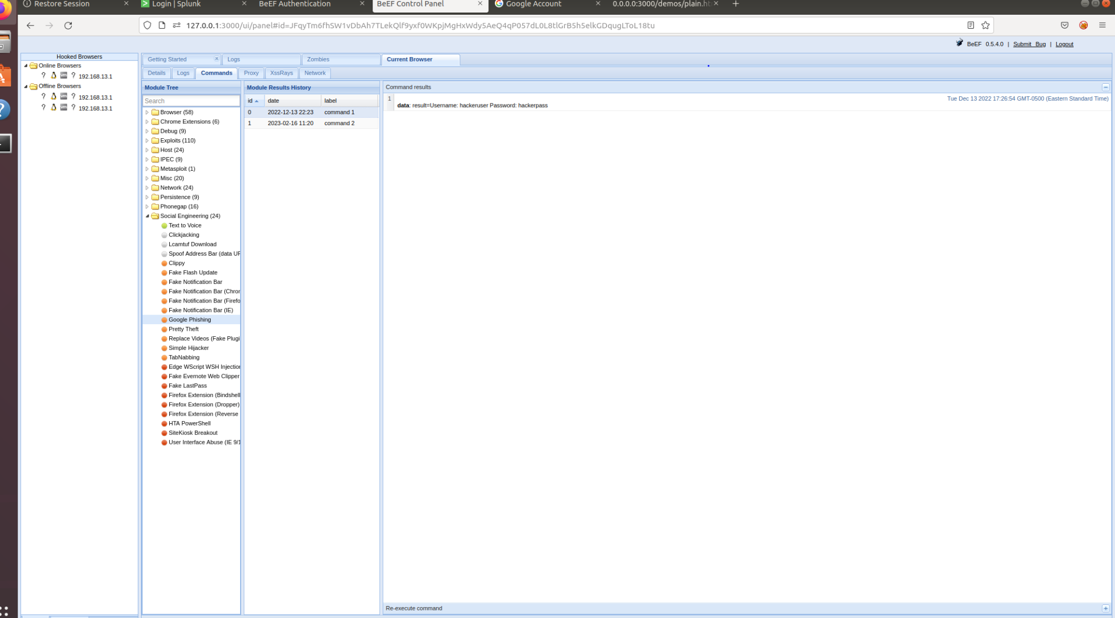
Captured user credentials as shown in the BeEF control panel

Slide 12
Mitigation against Social Engineering
Education on cybersecurity awareness
Implementation of email threat protection
Keeping antivirus softwares up to date
Regular system patching
Implementing strong firewall rules
Secure spam filter to high
Do not access unsecure websites
Organisations should have a list of restricted websites

Slide 13
Q&A

